Slide 1
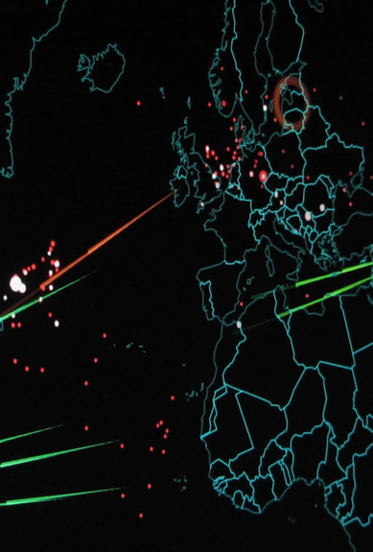
Rise of Cyber Warfare Tactics and Their Threat to National
Sovereignties
Jamison Durham
Cybersecuirty Foundations – CYB 150
Due: November 19, 2025

Slide 2
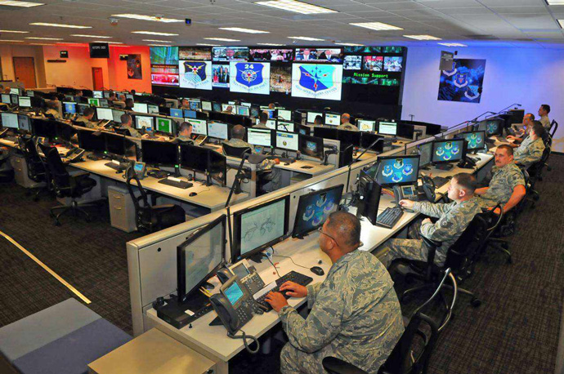
Table of Contents
3) Introduction - What is Cyber Warfare
4) Case Study – Real World Examples
Modern Day Cyber War Tactics
Modern Day Cyber War Tactics Con.
Defense Strategies
Cyber Warfare Statistics and Data
Conclusion Threat to National Sovereignties and Security?
References
Questions

Slide 3
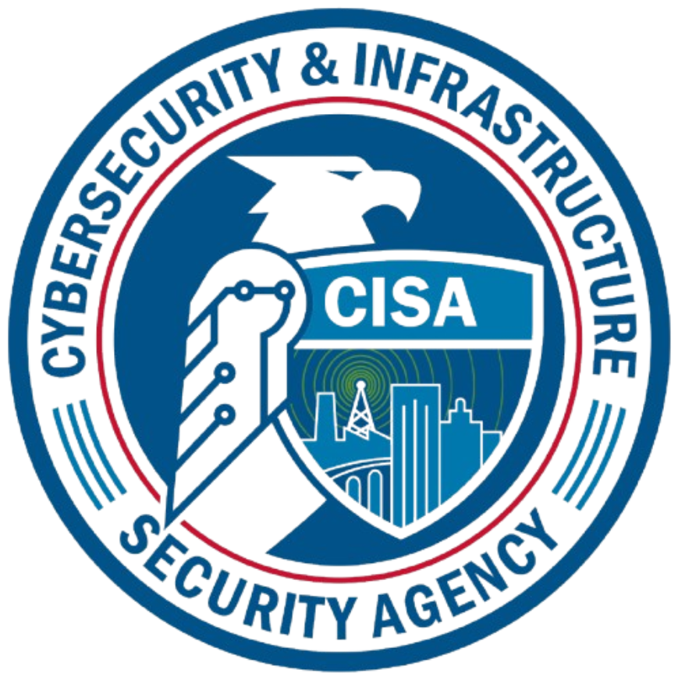

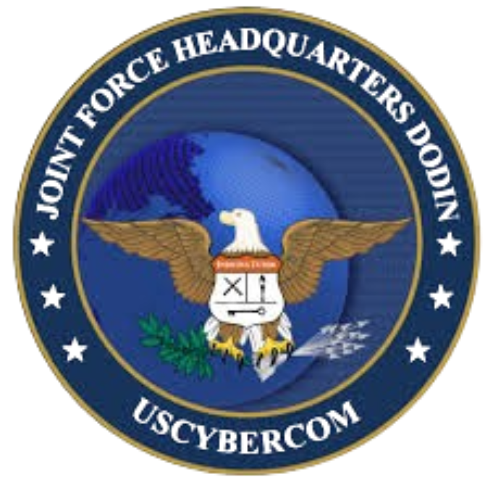
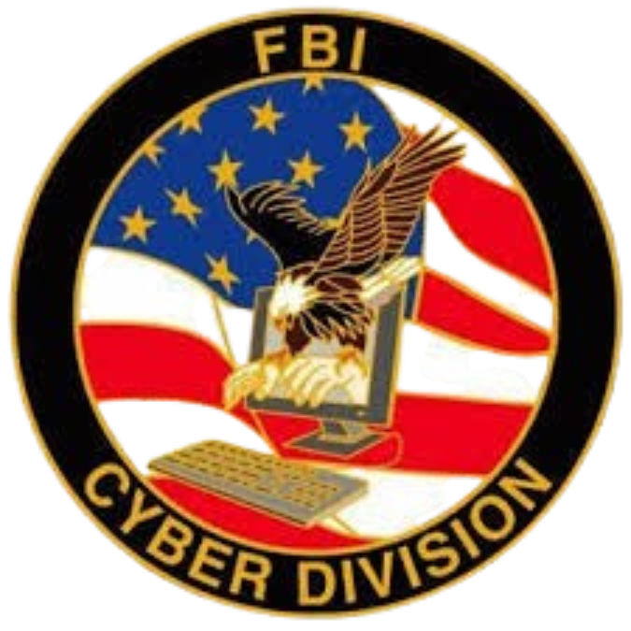
Introduction – What is Cyber Warfare?
With the rise of technology and global tensions, the concern of cyber warfare rises as well.
CISA (Cybersecurity and Infrastructure Security Agency) defines cyber warfare as, “nation-state cyber attacks that disrupt or destroy a country's critical infrastructure, such as power grids, financial systems, or government networks.”
As digital infrastructure rises, cyberterrorism and cyber war tactics are becoming more of a concern for all governments.
23 major federal agencies, 100s of smaller divisions.

Slide 4
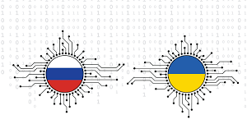
Case Study – Real World Examples
When you think of cyber warfare you probably think of big cyber warfare attacks such as the Russian-Ukrainian War. For example, in December of 2022, a Russian group by the name of Sandstorm, used malware to wipe out Ukraine's energy infrastructure.
Although cyber warfare is happening constantly, even without our knowledge. Meaning that there are many small attacks that are reported.
Some of these include (just in 2025):
July 2025
A Chinese cyber espionage group targeted African IT providers which serviced government employees.
August 2025
Pro-Russian hackers launched an attack on a Norway dam in Bremanger, seizing control to sow fear.
October 2025
North Korea ATP (Advanced Threat Protection) group were successful in a social engineering attack against three European defense companies to gain information about sensitive drone development.

Slide 5
Modern Day Cyber War Tactics
1)
Espionage
Also known as cyber spying, cyber espionage is when an unauthorized user attempts to access sensitive or classified data in order to harm the company, or simply for economic gain. In this case, to harm a government or citizens.
Ex. GhostNet: A large espionage operation which gained access to compromised computers that were connected to Asian government systems. This was to gain information about Dalai Lama.
2)
Sabotage | Denial-of-Service (DoS) Attacks
As we have learned, a DoS attack is used when an attacker overwhelms a computer system or network to slow or to stop traffic. This renders it as unavailable, shutting down operations.
Ex. In 2014, a series of DDoS attacker were launched against PopVote, which was used to collect data for democratic protest and movements.
In 2007, a dispute broke out between Russia and Estonia. In response Russia launched DDoS attacks to block citizens from accessing banking information and government communications. As well as limiting access to the media.

Slide 6
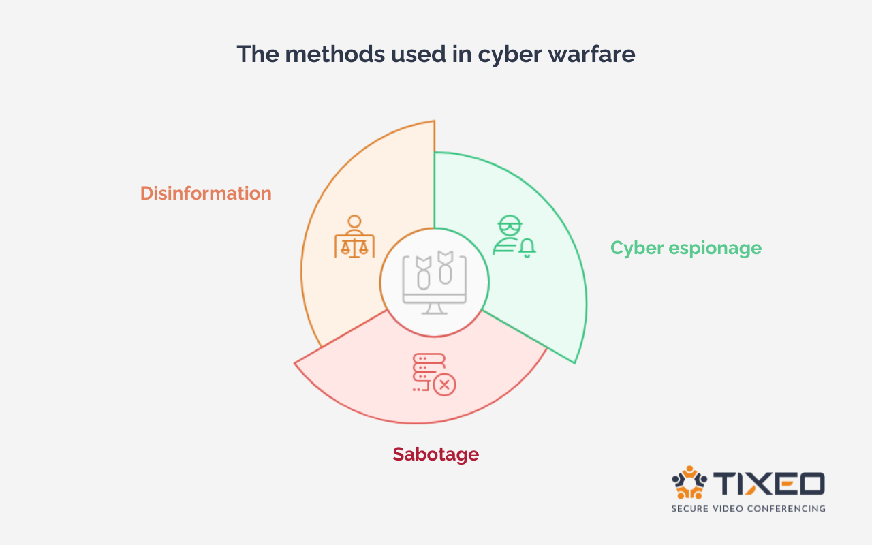
Modern Day Cyber War Tactics Con.
3)
Disinformation
Disinformation is commonly used during elections or in subversion attempts. The goal of disinformation is more commonly used to influence political opinion about a party or institution.
This can lead to instable politics, lost of trust in the government, and can even disrupt or collapse a government.
Ex. The Dutch released a study stating, “A vast coordinated network of accounts influenced public discourse on social networks in Germany and France ahead of the European elections in June 2024.”

Slide 7
Defense Strategies
There are many ways that the U.S are continuing to advance defense strategies, some even including AI detection.
Layered Security
Use multiple layers with any infrastructures or government network such as network firewalls, IDS/IPS, and limited access for employees.
2) Access Controls or Zero Trust
Continue to verify attacks and weaknesses, even internal traffic. Ex. Multi-Factor Authentication.
3) Encryption
Encrypting data both in transit and when its not in transit. This alone would reduce some espionage attempts.
4) DoS Protection
Implementing DoS mitigation techniques to filter traffic.
5) AI / Machine Learning
Allow AI to recheck human detections using security tools with network data and traffic. This would detect anomalies quicker, limiting damage.

Slide 8
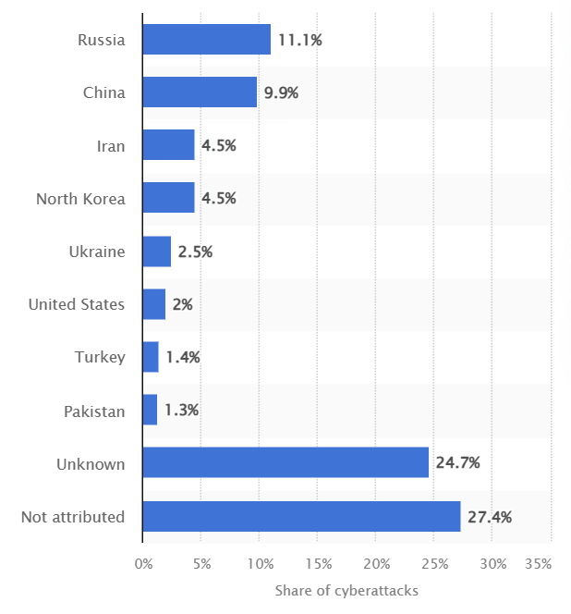
Cyber Warfare Statistics and Data
Over the last 25 years over 11% of cyber attacks with political influence were launched by Russia. Then China with similar shares. Both Iran and North Korea initiated around 4.5%.
Reported in 2024, 178 cyberattacks with political motivation were launch
Against the United States.
In 2025, the USA government proposed almost 13 billion in advancing
cybersecurity.
The World Economic Forum stated. “72% of respondents say
cyber risks have risen in the past year.”
- Since 2005, 34 countries have been caught or suspected of sponsoring cyber operations with politics. Iran, North Korea, China, and Russia with over 77% of suspected operations.

Slide 9
Conclusion Threat to National Soverignties and Security?
Anyone concerned about the safety of their country should understand that cyber warfare is 100% a threat to the country's national sovereignty and security.
The CISA states, “Nation-state actors and nation states sponsored entities pose an elevated threat to our national security.”
More specifically for the United States of America, the CISA labels the following nation-states as the biggest threat when it comes to cyber warfare. These are known through their advanced persistent threat activity (ATP).
The Chinese Government – People’s Republic of China (PRC)
Often engages in malicious cyber actives to pursue national interest.
2) The Iranian Government – Islamic Republic of Iran
Continues to increase cyber capabilities and skills to limit internal political activities and “to harm international adversaries.”
The North Korean Government – Democratic People’s Republic of Korea (DPRK)
Implements malicious cyber activity to collect information and intelligence, as well as generating revenue.
4) The Russian Government – Russian Federation
Often conducts attacks for cyber espionage, as well as to suppress political activity.

Slide 10
References
https://www.apu.apus.edu/area-of-study/information-technology/resources/what-is-cyber-warfare/
https://tdhj.org/blog/post/ai-cyber-warfare/
https://cybersecurityguide.org/resources/cyberwarfare/
https://www.crowdstrike.com/en-us/cybersecurity-101/threat-intelligence/cyber-espionage/
https://www.csis.org/programs/strategic-technologies-program/significant-cyber-incidents
https://blog.tixeo.com/en/cyberwarfare-strategies-threats-and-global-geopolitical-challenges/
https://www.euronews.com/my-europe/2024/07/18/huge-disinformation-networks-ensnared-france-and-germany-ahead-of-eu-elections
https://www.cisa.gov/topics/cyber-threats-and-advisories/nation-state-cyber-actors

Slide 11
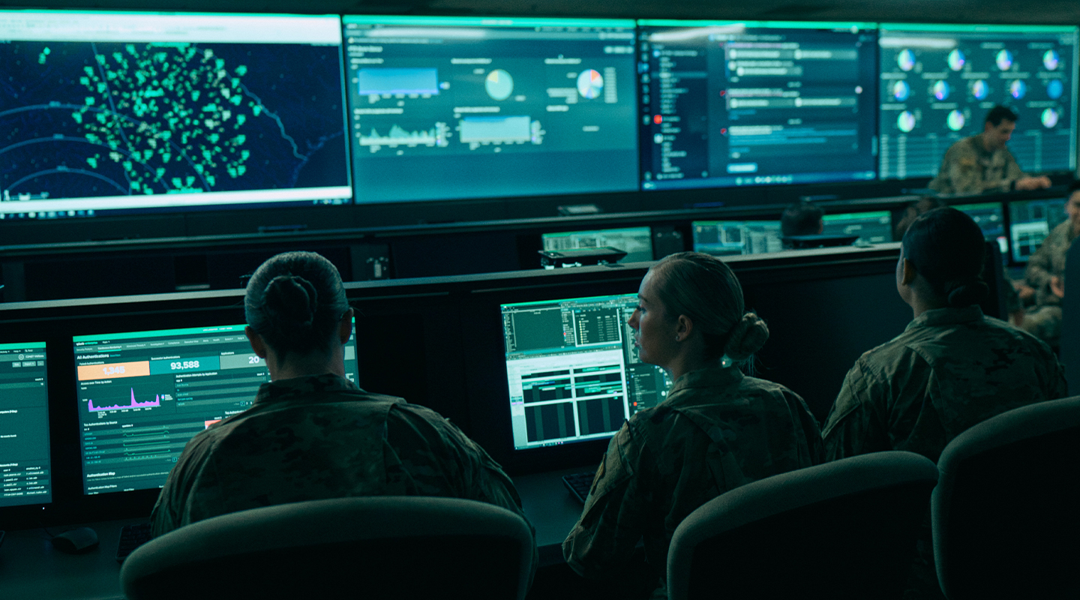
Questions?

